Slide 1

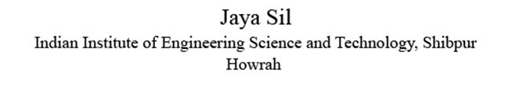
Deep Neural Architecture

Slide 2
Deep Learning Network
Deep learning networks are distinguished from the common single hidden layer network by their depth.
Each layer of nodes trains on a distinct set of features based on the previous layer‘s output.
The further you advance into the neural net, the more complex features the nodes can recognize., since they aggregate and recombine features from the previous layer.
Deep learning networks capable of handling very large, high dimensional datasets with billion of parameters that pass through nonlinear functions.

Slide 3
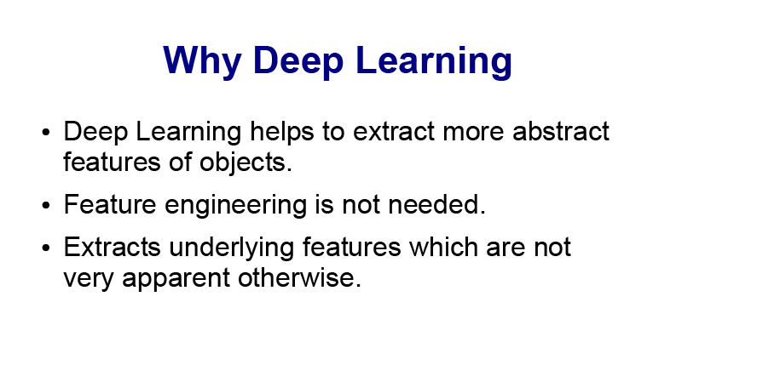

Slide 4
Deep Learning
Deep learning with massive computational power, model high-level abstractions in unlabeled data using a deep graph with multiple processing layers, composed of multiple linear and non-linear transformation.
Early neural networks could simulate only a very limited number of neurons at once, not recognize patterns of great complexity.
In the mid-1980s, Hinton and others revived neural networks with “deep” models using many layers of software neurons.
“ Deep learning is an advanced machine learning technique where multiple abstract layers communicating with each other and makes their decisions based on the output fed by previous layer “.

Slide 5
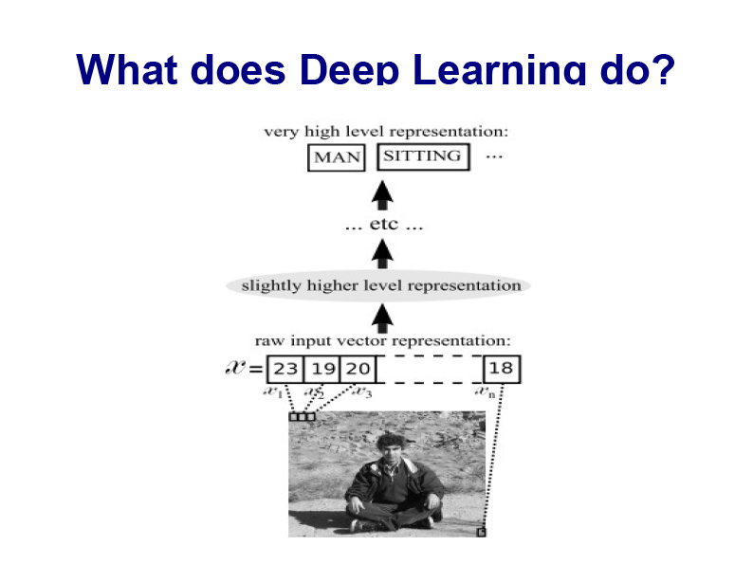

Slide 6
How to teach Individual Layers of Neurons
The first layer learns primitive features, like an edge in an image or the tiniest unit of speech sound.
Finding combinations of digitized pixels or sound waves that occur more often than they should by chance.
Once that layer accurately recognizes those features, they’re fed to the next layer, which trains itself to recognize more complex features, like a corner or a combination of speech sounds.
The process is repeated in successive layers until the system can reliably recognize phonemes or objects.

Slide 7
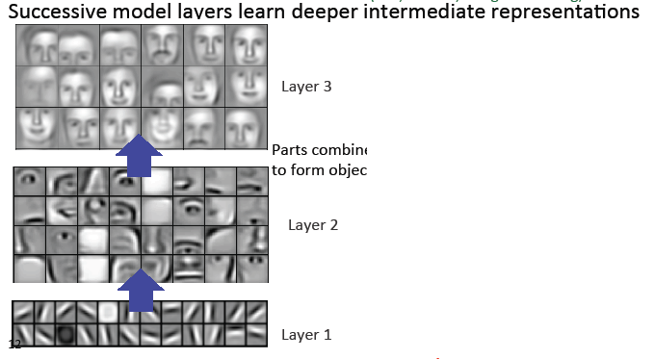
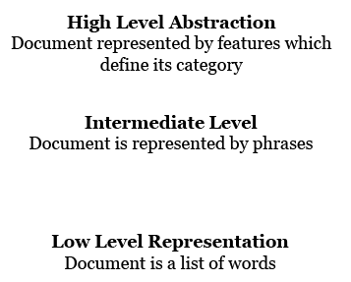
Mining for Structure

Slide 8
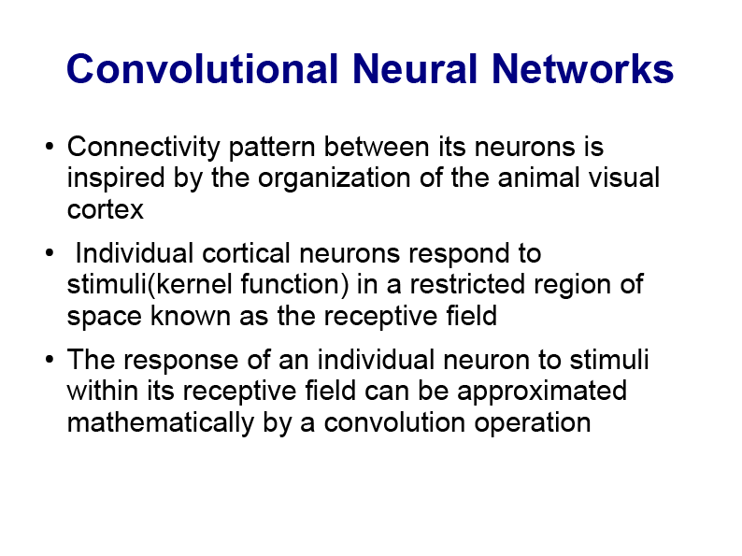

Slide 9
Convolution Neural Net
The structure of CNN is inspired by the complex arrangement of simple and complex cells of visual cortex.
Simple cells (convolution layer) are connected to a small subregion of the previous layer and need tiled to cover the entire visual space.
Complex cells (Pooling layer) combine the activation of simple cells to add robustness to small translation.
After several convolution and pooling layers, the activation of last convolution layer are fed into one or more dense layers to carry out the final classification task.

Slide 10
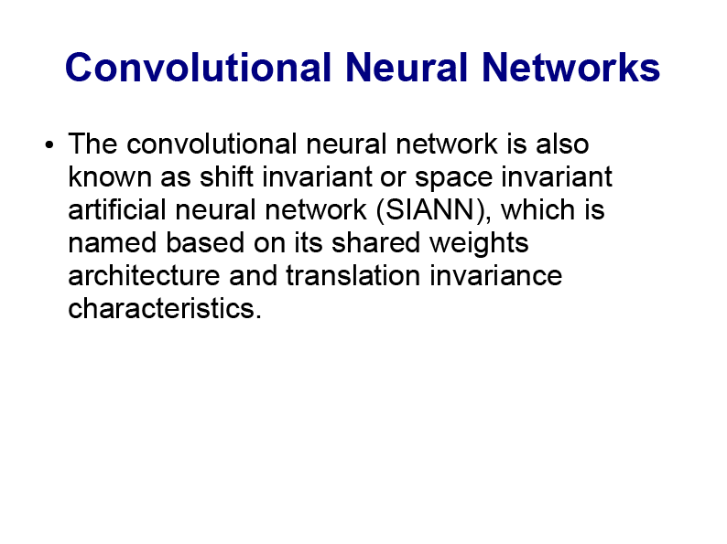
Main insight is that invariance to irrelevant transformations and sensitivity to local image statistics can be achieved by measuring distances in a suitable feature space. Convolutional networks provide a feature representation with desirable properties. They are invariant to small, smooth deformations but sensitive to perceptually important image properties, like salient edges and textures.

Slide 11
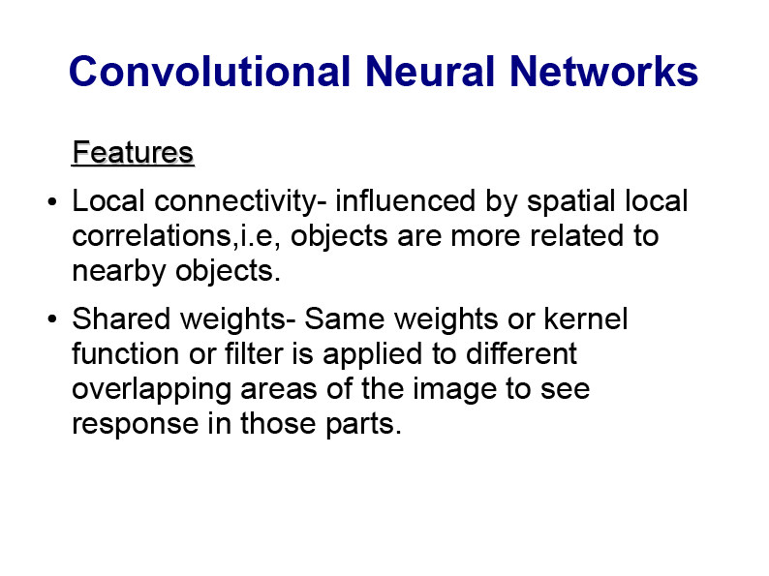

Slide 12
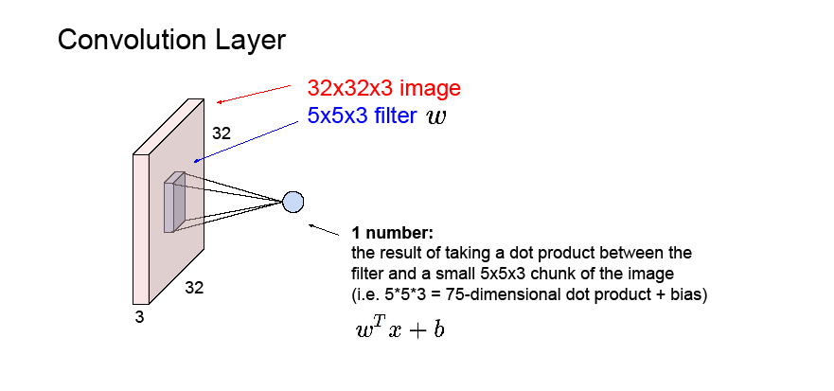

Slide 13
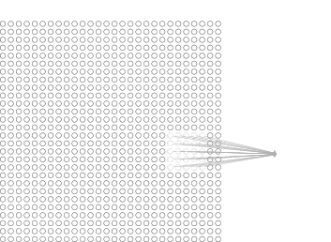
Local Receptive field
Each neuron in the first hidden layer will be connected to a small region of the input neurons
Hidden neuron
The region in the input image is called the local receptive field for the hidden neuron.
Each connection learns a weight.

Slide 14
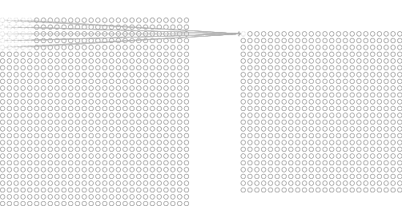
Hidden Layer
Slide the local receptive field across the entire input image and by sliding one pixel to the right (by one neuron), connect to a second hidden neuron and so on building the first hidden layer.
For each local receptive field, there is a different hidden neuron in the first hidden layer.
First Hidden layer
A different stride length is also used

Slide 15
Similar with Ordinary NN
Convolutional Neural Networks are very similar to ordinary Neural Networks.
CNN are made up of neurons that have learnable weights and biases.
Each neuron receives some inputs, performs a dot product and optionally follows it with a non-linearity.
The network have a loss function (e.g. SVM/Softmax) on the last (fully-connected) layer and all steps of learning regular Neural Networks still apply.

Slide 16
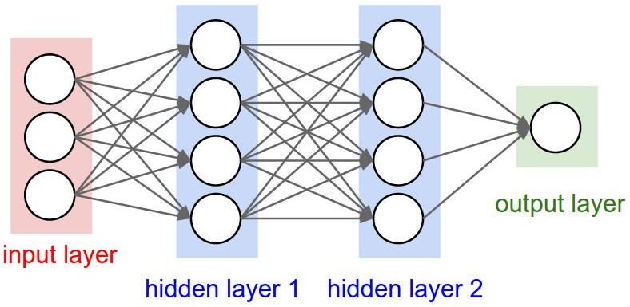
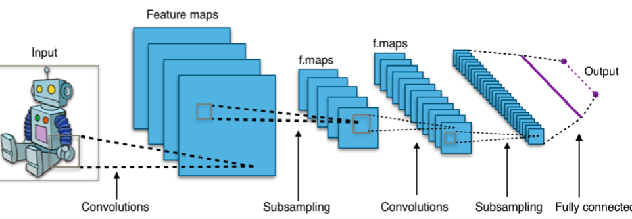
A regular 3-layer Neural Network.

Slide 17
The input consists of images and constrain the architecture in a more sensible way.
The neurons in a layer are connected to a small region of the layer before it, instead of all of the neurons in a fully-connected manner.
The final output layer have dimensions 1×1×10, because by the end of the ConvNet architecture we will reduce the full image into a single vector of class scores, arranged along the depth dimension.
A CNN is comprised of one or more convolutional layers (often with a subsampling step) and then followed by one or more fully connected layers as in a standard multilayer neural network.
Local connections and tied weights followed by some form of pooling results in translation invariant features.
Another benefit of CNNs is that they are easier to train and have many fewer parameters than fully connected networks with the same number of hidden units.

Slide 18
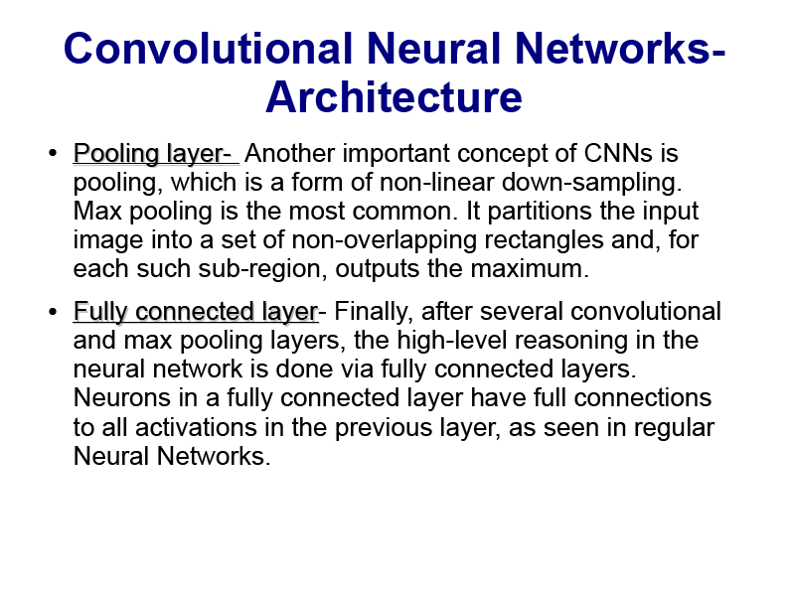

Slide 19
So what does change?
It makes the forward function more efficient to implement and vastly reduce the amount of parameters in the network.
Regular Neural Nets don’t scale well to full images.
For example, an image of size, 200×200×3 (200 wide, 200 high, 3 color channels), would lead to a single fully-connected neuron in a first hidden layer with 200×200×3 = 120,000 weights.
Full connectivity is wasteful and the huge number of parameters would quickly lead to overfitting.

Slide 20
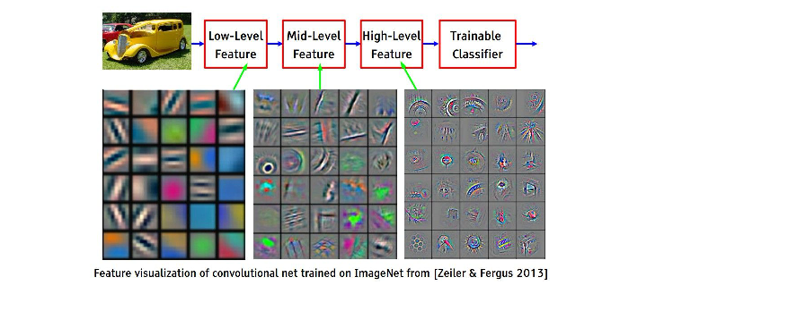

Slide 21
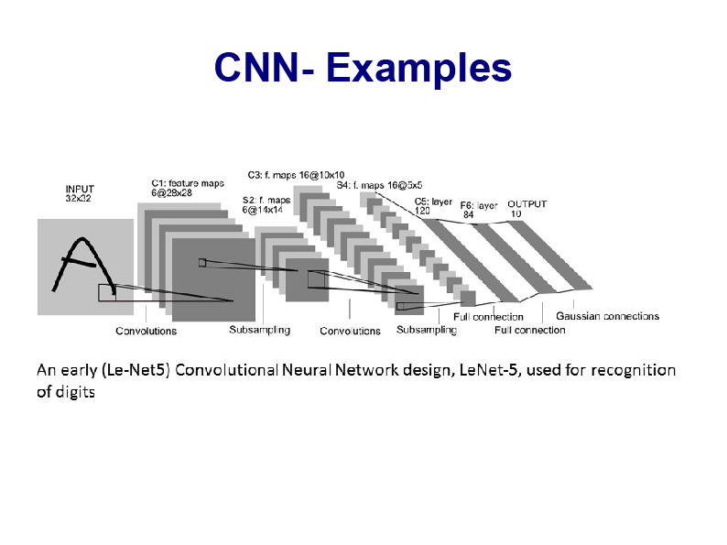

Slide 22
Functions
ConvNets transform the original image layer by layer from the original pixel values to the final class scores.
Some layers contain parameters and other don’t.
In particular, the CONV/FC layers perform transformations that are a function of not only the activations in the input volume, but also of the parameters (the weights and biases of the neurons).
On the other hand, the ReLU/POOL layers implement a fixed function.
The parameters in the CONV/FC layers are trained with gradient descent so that the class scores that the ConvNet computes are consistent with the labels in the training set for each image.

Slide 23
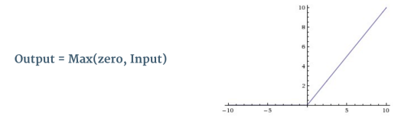
Non Linearity (ReLU)
ReLU stands for Rectified Linear Unit and is a non-linear operation and has been used after every Convolution operation.
ReLU is an element wise operation applied per pixel and replaces all negative pixel values in the feature map by zero.
The purpose of ReLU is to introduce non-linearity in our ConvNet, since most of the real-world data we would want our ConvNet to learn would be non-linear (Convolution is a linear operation – element wise matrix multiplication and addition, so we account for non-linearity by introducing a non-linear function like ReLU).

Slide 24
The Pooling Step
Spatial Pooling (also called subsampling or downsampling) reduces the dimensionality of each feature map but retains the most important information. Spatial Pooling can be of different types: Max, Average, Sum etc.
In case of Max Pooling, we define a spatial neighborhood (for example, a 2×2 window) and take the largest element from the rectified feature map within that window.
Instead of taking the largest element we could also take the average (Average Pooling) or sum of all elements in that window. In practice, Max Pooling has been shown to work better.

Slide 25
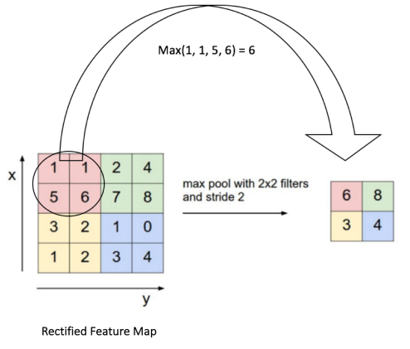
Max Pooling
Pooling reduces the dimensionality of our feature map.
pooling operation is applied separately to each feature map

Slide 26
Fully Connected Layer
The Fully Connected layer is a traditional Multi Layer Perceptron that uses a softmax activation function in the output layer.
The term “Fully Connected” implies that every neuron in the previous layer is connected to every neuron on the next layer.
The output from the convolutional and pooling layers represent high-level features of the input image.
The purpose of the Fully Connected layer is to use these features for classifying the input image into various classes based on the training dataset.

Slide 27
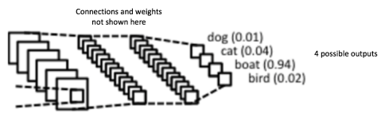
Classification
Apart from classification, adding a fully-connected layer is also a (usually) cheap way of learning non-linear combinations of these features.
Most of the features from convolutional and pooling layers may be good for the classification task, but combinations of those features might be even better.
The sum of output probabilities from the Fully Connected Layer is 1 ensured by using the Softmax as the activation function.
The Softmax function takes a vector of arbitrary real-valued scores and squashes it to a vector of values between zero and one that sum to one.

Slide 28
Architecture
A ConvNet for CIFAR-10 classification have the architecture [INPUT - CONV - ReLU - POOL - FC]
INPUT: [32×32×3] raw pixel values of image.
CONV layer computes the output of neurons connected to local regions in the input using 12 filters.
ReLU layer applies an element wise activation function, such as the max(0, x); thresholding at zero.
POOL layer performs a downsampling operation resulting [16×16×12].
FC layer will compute the class scores of 10 numbers, resulting in volume of size [1×1×10], representing 10 categories of CIFAR-10.

Slide 29
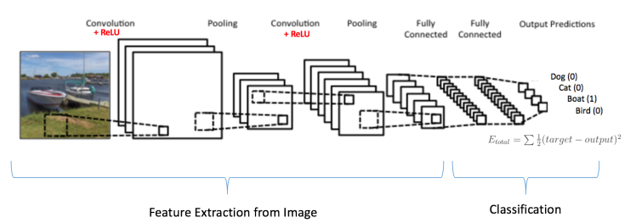
Training using Backpropagation
The Convolution + Pooling layers act as Feature Extractors from the input image while Fully Connected layer acts as a classifier.
Note that, since the input image is a boat, the target probability is 1 for Boat class and 0 for other three classes, i.e. Input Image = Boat and Target Vector = [0, 0, 1, 0]

Slide 30
Step1: Initialize filters and weights with random values
Step2: The network takes a training image as input, then forward propagation step (convolution, ReLU and pooling operations along with forward propagation in the Fully Connected layer) and finds the output probabilities for each class.
Lets say the output probabilities for the boat image above are [0.2, 0.4, 0.1, 0.3]
Since weights are randomly assigned for the first training example, output probabilities are also random.
Step3: Calculate the total error at the output layer
Total Error = ∑ ½ (target probability – output probability) ²

Slide 31
Step4: Use Backpropagation to calculate the gradients of the error with respect to all weights in the network and use gradient descent to update all filter values / weights and parameter values to minimize the output error.
The weights are adjusted in proportion to their contribution to the total error.
When the same image is input again, output probabilities might now be [0.1, 0.1, 0.7, 0.1], which is closer to the target vector [0, 0, 1, 0].
This means that the network has learnt to classify this particular image correctly by adjusting its weights / filters such that the output error is reduced.

Slide 32
Parameters like number of filters, filter sizes, architecture of the network etc. have all been fixed before Step 1 and do not change during training process – only the values of the filter matrix and connection weights get updated.
Step5: Repeat steps 2-4 with all images.

Slide 33
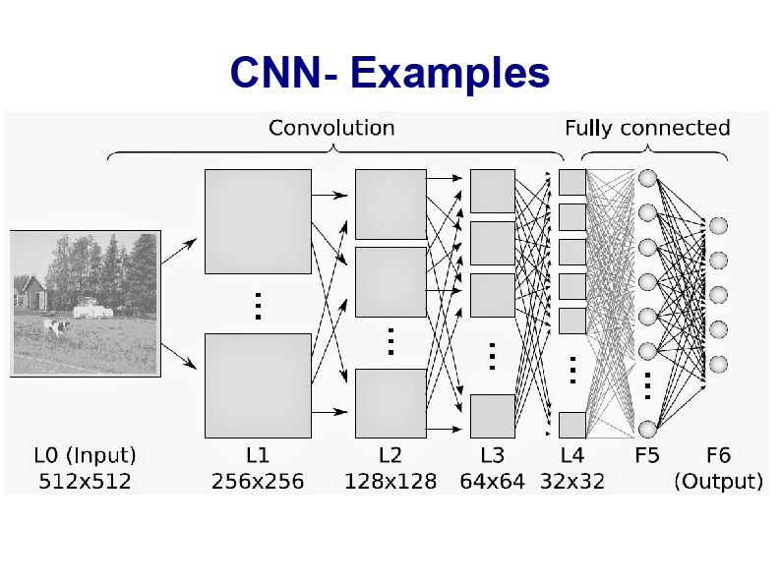

Slide 34
How can we train such deep networks?
Deep networks not performing much better than shallow networks using stochastic gradient descent by backpropagation
Different layers in deep network are learning at vastly different speeds.
When later layers (early layers) in the network are learning well, early layers (later layer) often get stuck during training, learning almost nothing at all.
There's an intrinsic instability associated to learning by gradient descent in deep, many-layer neural networks resulting resulting stuck at during training either the early or the later layers.

Slide 35
Problem with Learning Algorithm
Assume that the extra hidden layers really could help in principle, and the problem is that our learning algorithm isn't finding the right weights and biases.
The gradient tends to get smaller as we move backward through the hidden layers. Neurons in the earlier layers learn much more slowly than neurons in later layers.
The phenomenon is known as the vanishing gradient problem.
More generally, it turns out that the gradient in deep neural networks is unstable, tending to either explode or vanish in earlier layers.
This instability is a fundamental problem for gradient-based learning in deep neural networks.

